Slide 1


HUA Site Application Review – Atlas Integration
December 2007

Slide 2
Agenda
Guiding Principles & Considerations
HUA Application Overview
High Level AS-IS / GoLive TO-BE / Future Direction
Support Considerations
Infrastructure Considerations
Next Steps……

Slide 3
Guiding Principles & Considerations
Sales reporting to ONLY occur in BW (single source of truth)
Local Application testing to be completed by P3W2
Minimise development effort – focus on integration
Minimise data to/from Data Warehouse
Supportable solutions (either centrally or locally)
Provide a base applications architecture to move forwards with

Slide 4
HUA Application Overview
Factory System (Shiftlog) - ne
Sales Web Portal & Vendor Managed Inventory (External)
Route To Market (RTM)
Trade Promotions Management/Reporting
Call Card System (Outlet Maintenance & Local Hierachy)
Scan Data
Reporting:
Trade Term Rebates
Web Ordering review
Vendor Managed Inventory (Wholesaler Inventory)
Call Card Reporting

Slide 5
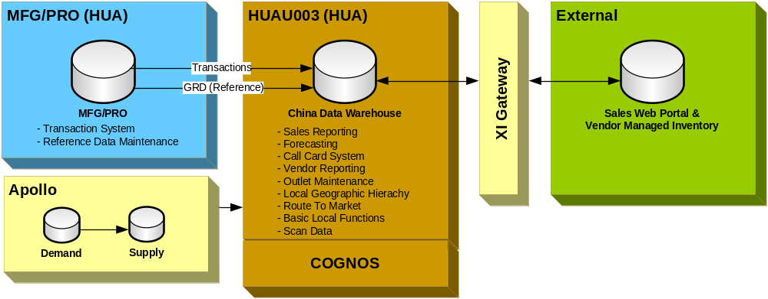
As-Is : High Level

Slide 6
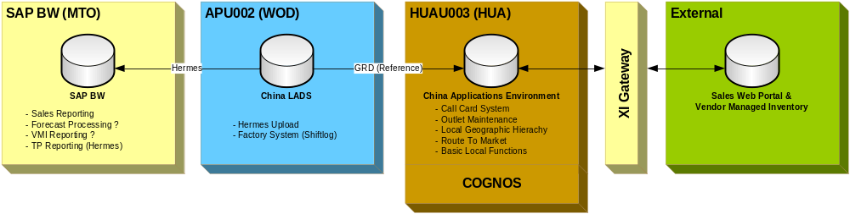
Atlas Go-Live : High Level
HUAU003 required for Atlas Go-Live – although reduced capacity as not “Data Warehouse”
Cognos to remain – known solution, reduced development effort vs. BO, minimised business disruption, no cost
Forecast Processing location TBD
Similar approach to MFANZ

Slide 7
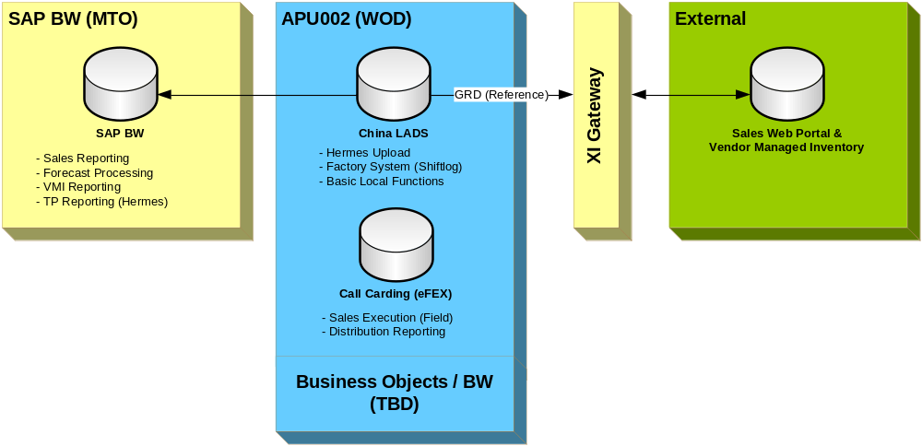
2008 – 09 : High Level Direction

Slide 8
Support Considerations
Local applications continue to be supported locally
As per MFANZ, MFJ, etc.
Regional/Global solutions to be supported regionally/globally – e.g. BW, ICS/LADS, Apollo, etc.
Generation of LADS -> HUA GRD extracts supported by GSM Information Delivery
Guidance/Best Practice available from GSM Information Delivery as required

Slide 9
Infrastructure Considerations
Atlas Go-Live
HUAU003 will remain in HUA (lower capacity)
New “China Applications Environment” DB to be created
China LADS environment to remain in WOD
Minimal WAN traffic WOD -> HUA
(only sending GRD once / day)
Post Atlas Go-Live
Migrate applications to China LADS as possible – ultimately decomission HUAU003
Review migration of China LADS from WOD -> MTO

Slide 10
Next Steps
Finalise Functional Requirement gathering – all applications
Agree drop-dead dates with BW Development Team for local solution “backup” (ie. Forecast)
Request/Complete HUA Applications Environment creation
Generate Site Team project plan for development delivery & BIT ready for P3W2 – including resourcing.

